Slide 1
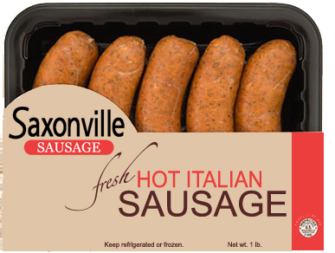
The Italian Opportunity
Saxonville Sausage
Emma Brooke and Jackie Cremer

Slide 2
Background
Saxonville
70-year-old business specializing in fresh pork sausage
Revenues
Bratwurst no growth in industry
70% of Saxonville’s revenues
Breakfast sausage: no growth in industry
Saxonville experienced a double-digit revenue decline
Ranked 6th out of 8 national breakfast sausage brands
Links and patties
20% of revenues
And an Italian sausage named Vivio (5% of revenues.)

Slide 3
Background
Vivio
Price competitively with competition
20% higher price than store brands
Currently only available in 16% of U.S. large super-markets (mostly on the East Coast)
Competition
29 locally branded competitors
No one distributes nationally
Only national players are in frozen categories
Market: growing
9% in 2004
15% in 2005
Italian Opportunity
Why has no one put national brands and Italian brands together?
Associated with local, regional sausage
Lack of creativity for national distribution
Goes against “farm-to-market” idea

Slide 4
Objectives
Choose a positioning statement for Saxonville’s national Italian sausage brand
Decide whether or not to keep the Vivio name, use the Saxonville name, or use a different naming strategy.
Make sure not to cannibalize other Saxonville products.
Decide which advertising, packaging, and product attributes should be used.

Slide 5
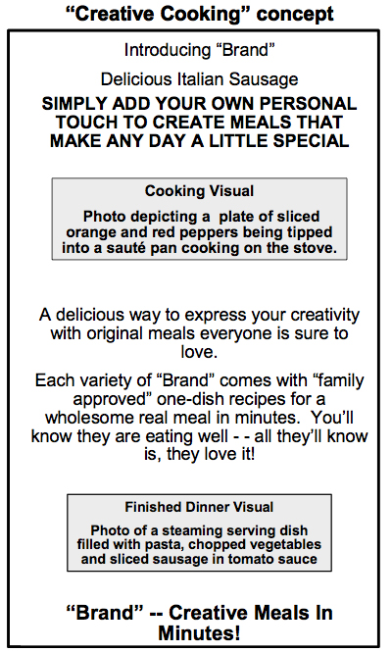
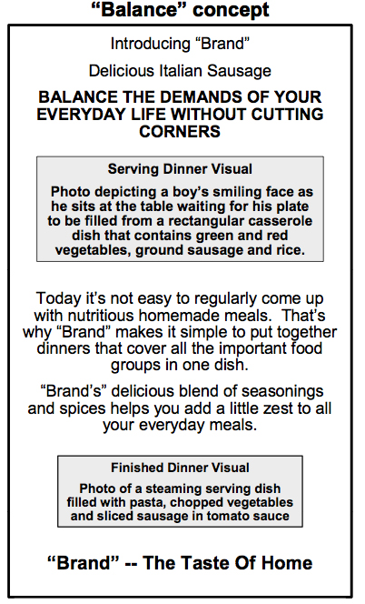
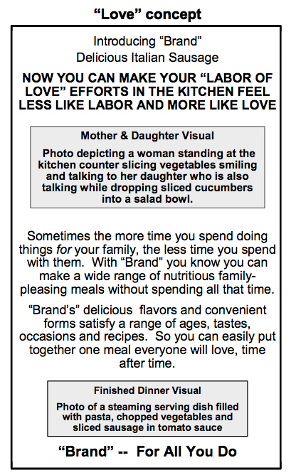
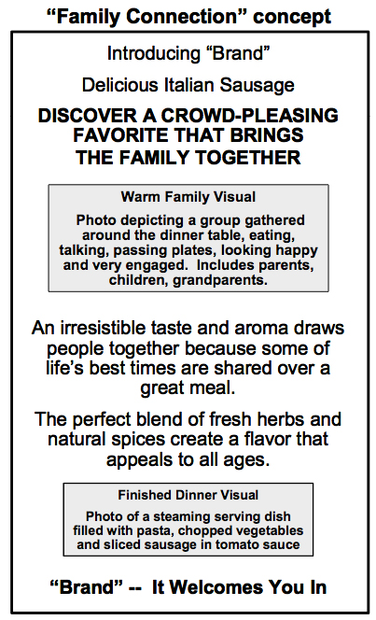
Concept Statements

Slide 6
Creative Meals in Minutes!
Ranked as the best concept in the monadic testing – received more “definitely would buy” ratings than Family Connection
Emphasis on combining Italian sausage with different ingredients
Differentiation: because the concept is completely unlike those of the competition, its focus is on points of differentiation

Slide 7
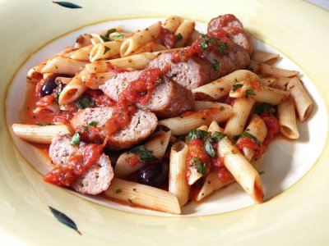
INTRODUCING
Creative Meals in Minutes!
Simply add your own personal touch to create meals that make any day a little special
A delicious way to express your creativity with original meals everyone is sure to love.
Each variety of Saxonville comes with “family approved” one-dish recipes for a wholesome real meal in minutes. You’ll know they are eating well– all they’ll know is, they love it!
Did better in the monadic testing setting
Recipes
more differntiation

Slide 8
It Welcomes
you in!
Ranked as the best choice in dyadic consumer testing – received 37 first-choice votes compared to Clever Cooking’s 14 first-choice votes
Simple easy recipes and ingredient substitution
Parity: emphasizes characteristics such as “irresistible taste and aroma”, “perfect blend of fresh herbs”, “natural spices” and its appealing “flavor” – these are points of parity that are necessary to convince consumers that the product is of a high quality in comparison to its competition

Slide 9
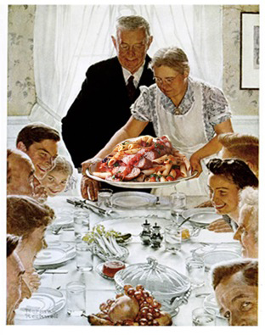
INTRODUCING
It Welcomes you in!
Discover a crowd-pleasing favorite that
brings the whole family together!
An irresistible taste and aroma draws people together because some of life’s best times are shared over a great meal.
The perfect blend of fresh herbs
And natural spices create a flavor
That appeals to all ages.
Simple easy recipes
More similarities/parity – understand it’s a good brand – not the best persay
Notes:
Simple easy recipes
More similarities/parity – understand it’s a good brand – not the best persay

Slide 10
Monadic
Monadic: a respondent is asked to rate an item on some form of scale WITHOUT comparison to another product or service (MRW)
Respondent is shown a concept statement and asked how likely they are to purchase the product
When only one option is shown at a time, Clever Cooking is preferred
Definitely Probably Might Probably not Definitely not

Slide 11
Dyadic
In the dyadic testing situation a respondent is asked to rate an item on some form of scale WITH comparison to another product or service (MRW)
Consumer is asked to rate first choice, second choice, and third choice
When subjects were presented with multiple positioning options, Family Connection is preferred

Slide 12
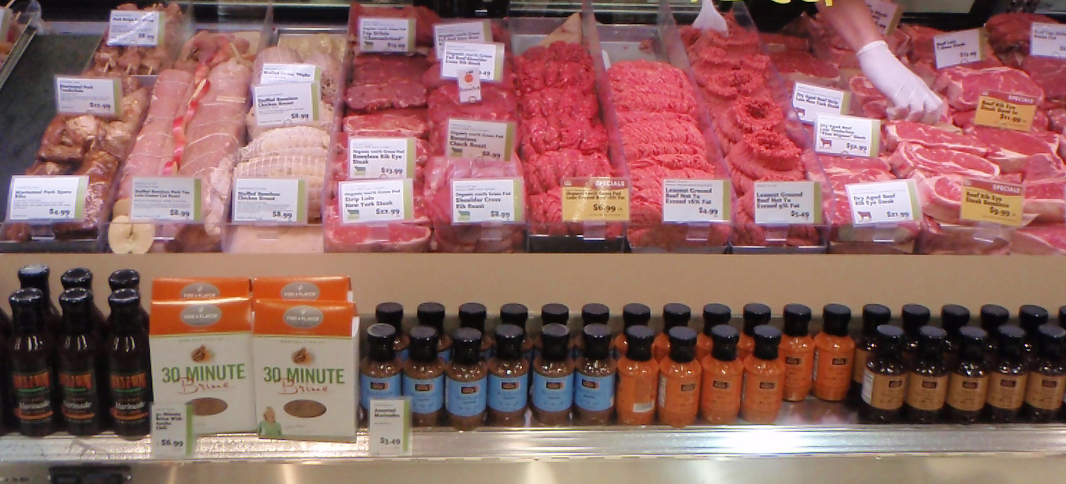
Monadic vs. Dyadic
We decided to focus more on the dyadic results because in those experiments, like in the “real-world” – you are shown multiple branding strategies and asked to choose between them. We believe this is a more representative way of how people choose their products.
Based on input from Dennis Rosen
Research suggestion

Slide 13
Brand Development
Framing: a new brand must establish a clear frame of reference in the mind of the consumer
Consumers must be convinced that the product meets all minimum requirements
Points of parity: product must match the competitors’ product benefits
Until consumers know that a product will stand up to the quality of it’s competitors – differentiation is useless

Slide 14
Objectives
Choose a positioning statement for Saxonville’s national Italian sausage brand
Decide whether or not to keep the Vivio name, use the Saxonville name, or use a different naming strategy.
Make sure not to cannibalize other Saxonville products.
Decide which advertising, packaging, and product attributes should be used.

Slide 15
Choice: Family Connection
Justifications
Brand development – points of parity
Dyadic data – more representative of a real life situation
Based Family Connection is far superior to any other position, including Clever Cooking, We chose to use a Family Connection branding strategy.
No sausage brand is currently making the push from ‘Italian’ to ‘Family’

Slide 16
INTRODUCING
It Welcomes you in!
Discover a crowd-pleasing favorite that
brings the whole family together!
An irresistible taste and aroma draws people together because some of life’s best times are shared over a great meal.
The perfect blend of fresh herbs
And natural spices create a flavor
That appeals to all ages.
Simple easy recipes
More similarities/parity – understand it’s a good brand – not the best persay
Notes:
Simple easy recipes
More similarities/parity – understand it’s a good brand – not the best persay

Slide 17
Cross-Promotional Packaging or “Grocery Basket”
Products
Sweet Cherry Tomato Peppers
Pastas (i.e. Barilla)
Pizza crusts
Based on market research
Input from Hy-Vee employees
Financial research necessary

Slide 18
Celebrity Endorsements
Option: use a celebrity such as Rachel Ray as a celebrity sponsor (in ads)
Top reasons for using celebrity campaigns
Standing out from the competition – breaking through the “media clutter”
Brand awareness
Instant credibility or aspiration
PR coverage
*10 out of 12 advertising managers believe that celebrities build brand equity through a transfer of values and create enhanced brands*
Important selection criteria
Celebrity values
Product match
Popularity and credibility
Attractiveness

Slide 19
Rachael Ray
Food Network Star – Rachael Ray
41 years of age
Married John Cusimano in 2005
Began television career in 2006
Food Network Demographics
68% in the 18-54 range - 40% 35-54
60% women
41% with one or more children in the household
Median age: 45.5
Median household income: $63,215
Michael Smith, senior vice president of marketing and creative services for the network.
TFN: Brad Adgate, a media researcher, says that the Food Network targets adults 25-54 and “is safe for family viewing”.
Options:
Commercials
Give-aways on Ray’s show
“Rachael embodies and reflects the core viewer of Food Network. She’s a woman in her late 30s, early 40s, into finding quick and easy solutions, she’s relatable, bright, obviously works. She’s the most popular.”

Slide 20
Naming Saxonville’s Italian Sausage
Italy’s Best
Primo
Perfecto..
…
…
…
Vivio
…
…
…
…
…
…
…
…
…
…
…
…
…
Should the name be changed from Vivio to another name?
When respondents were given 20 possible brand names, Vivio ranked seventh after top-scorers Italy’s Best, Primo, and Perfecto.
Saxonville Italian Sausage received very few votes because the brand is associated with Germany.

Slide 21
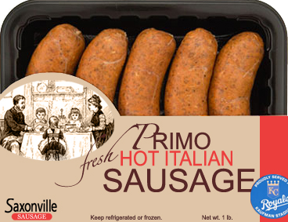
Implementation
PRIMO
Use Saxonville as a small subscript to advantage of brand recognition, while not emphasizing its German heritage
i.e. Rosewood
Family Positioning

Slide 22
References
Dennis Rosen
http://fulltext.ausport.gov.au/fulltext/1999/cjsm/v3n3/erdogan&baker33.htm
Three Questions You Need to Ask About Your Brand – Kevin Keller
http://www.marketresearchworld.net/index.php?option=com_glossary&task=list&glossid=13&letter=M
http://kansascity.royals.mlb.com/news/press_releases/press_release.jsp?ymd=20100331&content_id=9024904&vkey=pr_kc&fext=.jsp&c_id=kc

Slide 23
Want some?
ITALIAN SAUSAGE AND RICE
1 lb. Italian sausage (sliced)
1 1/2 c. water
2 med. green peppers
1 (16 oz.) can tomatoes
1/2 tsp. salt
1 1/2 c. precooked rice
Put sausage and 1/2 cup water in skillet. Bring to boil.
Cover and simmer 15 minutes.
Remove cover and cook until water evaporates.
Add green peppers and cook until sausage is well browned.
Stir in remaining ingredients.
Bring to boil and cover.
Reduce heat and simmer 5 minutes.

